Slide 1
Geometric Transformations
Joe Manke, Adam Meaney, & Jonathan Tomes

Slide 2
Geometric Transformations
Modify the spatial relationship between pixels in an image
Consists of 2 basic operations
Spatial transformation of coordinates
Intensity interpolation

Slide 3
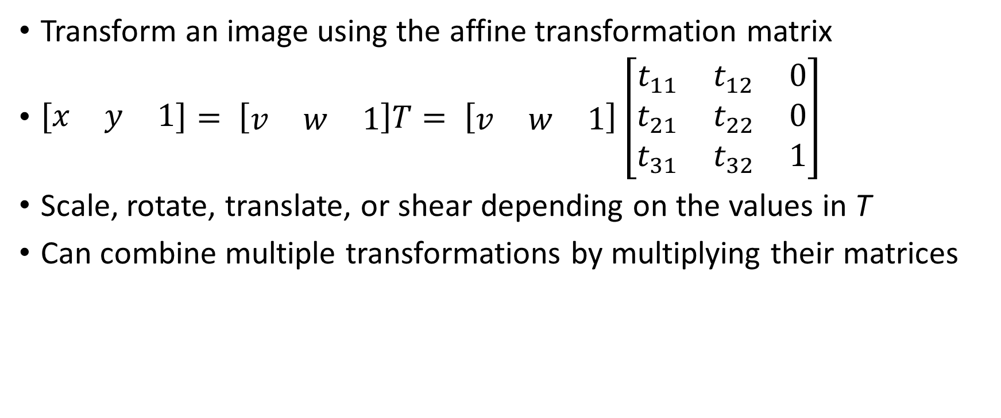
Affine Transformations
Transform an image using the affine transformation matrix
$\left[\begin{matrix}x & y & 1\end{matrix}\right]= \left[\begin{matrix}v & w & 1\end{matrix}\right]T= \left[\begin{matrix}v & w & 1\end{matrix}\right]\left[\begin{matrix}t_{11} & t_{12} & 0 \\ t_{21} & t_{22} & 0 \\ t_{31} & t_{32} & 1\end{matrix}\right]$
Scale, rotate, translate, or shear depending on the values in T
Can combine multiple transformations by multiplying their matrices

Slide 4
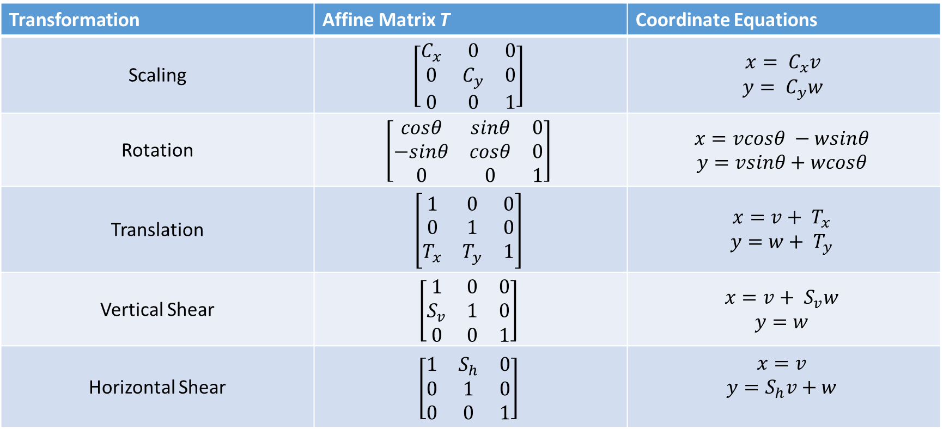
Affine Transformations
Transformation | Affine Matrix T | Coordinate Equations
Scaling | $$\left[\begin{matrix}C_{x} & 0 & 0 \\ 0 & C_{y} & 0 \\ 0 & 0 & 1\end{matrix}\right]$$ | $$x= C_{x}v$$ $y= C_{y}w$
Rotation | $$\left[\begin{matrix}cosθ & sinθ & 0 \\ −sinθ & cosθ & 0 \\ 0 & 0 & 1\end{matrix}\right]$$ | $$x=vcosθ −wsinθ$$ $$y=vsinθ+wcosθ$$
Translation | $$\left[\begin{matrix}1 & 0 & 0 \\ 0 & 1 & 0 \\ T_{x} & T_{y} & 1\end{matrix}\right]$$ | $$x=v+ T_{x}$$ $$y=w+ T_{y}$$
Vertical Shear | $$\left[\begin{matrix}1 & 0 & 0 \\ S_{v} & 1 & 0 \\ 0 & 0 & 1\end{matrix}\right]$$ | $$x=v+ S_{v}w$$ $$y=w$$
Horizontal Shear | $$\left[\begin{matrix}1 & S_{h} & 0 \\ 0 & 1 & 0 \\ 0 & 0 & 1\end{matrix}\right]$$ | $$x=v$$ $$y=S_{h}v+w$$

Slide 5
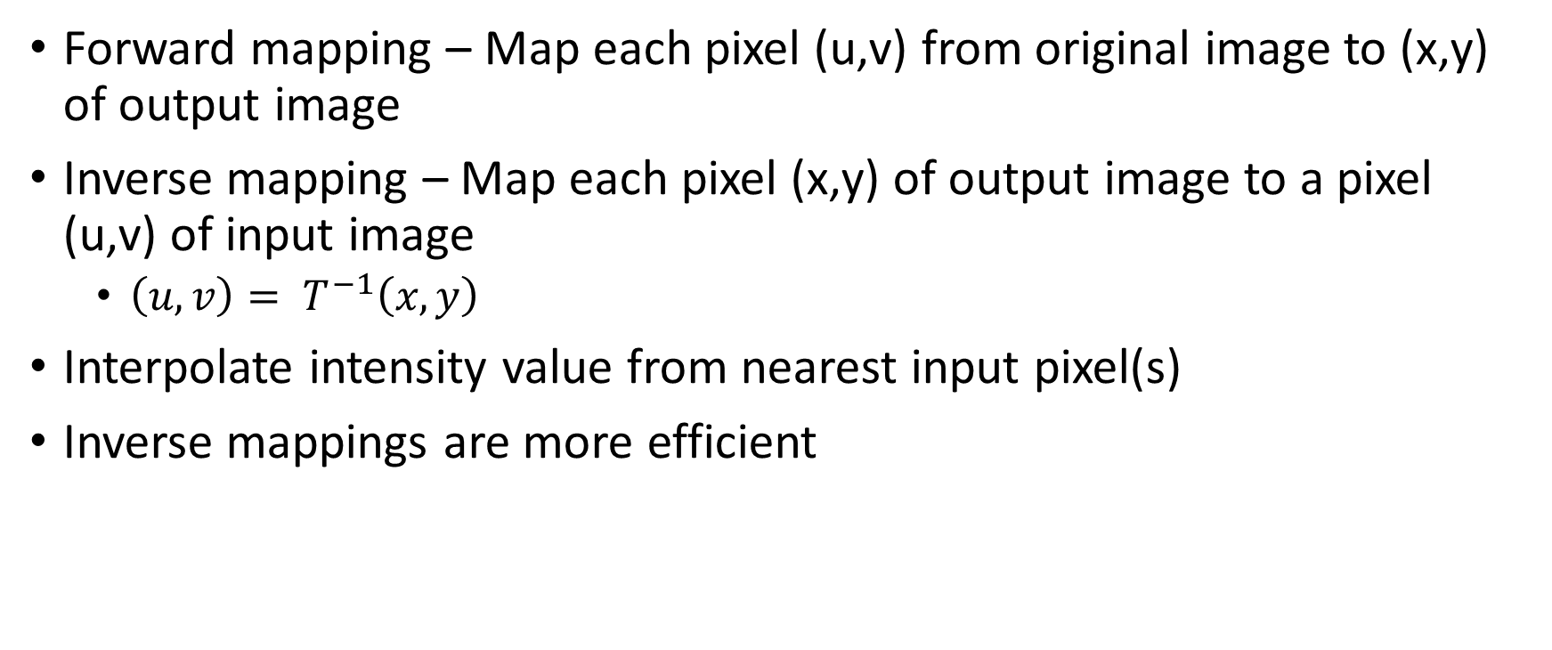
Mapping and Interpolation
Forward mapping – Map each pixel (u,v) from original image to (x,y) of output image
Inverse mapping – Map each pixel (x,y) of output image to a pixel (u,v) of input image
$\left(u,v\right)= T^{−1}\left(x,y\right)$
Interpolate intensity value from nearest input pixel(s)
Inverse mappings are more efficient

Slide 6
Nearest Neighbor Interpolation
Simplest technique – round (u,v) to nearest integer values, use that pixel’s intensity

Slide 7
References
Gonzalez, Rafael C., and Richard E. Woods. Digital Image Processing. 3rd ed. Upper Saddle River, NJ: Prentice Hall, 2008. Print.

